Slide 1
A .NET Developers Identity Journey
With Mike Benkovich
mike@benko.com | www.Benkotips.com | httpS://twitter.com/mbenko
Notes:
A .NET Developers Identity Journey
This session will explore how the identity story in .NET has evolved from early days of username/password to working with integrated and 3rd party identity providers. We will talk about what's new and how to implement basic identity with the tools available to the developer.

Slide 2
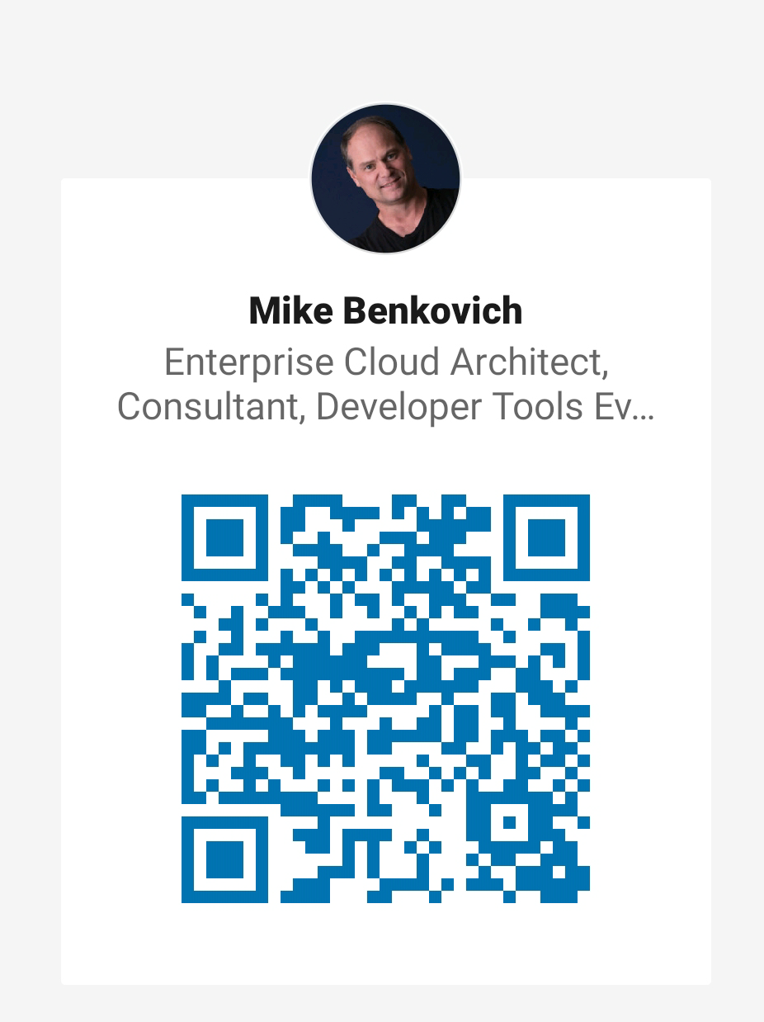
Mike Benkovich
- Developer
- Cloud Architect & Consultant
- Live in Minneapolis
- Founder of Imagine Technologies, Inc.
- Developing Courses for LinkedIn Learning
- Started TechMasters in 2009 (Toastmasters for Geeks)
- Blog www.benkoTIPS.com
- Follow @mbenko on Twitter
- Send me Feedback! mike@benkotips.com

Slide 3
Today
Identity, Security and .NET
Secure by Default
Authentication
Authorization
Next steps…

Slide 4
Demos
1. Default Identity
2. Scaffolding and Multifactor Auth
3. 3rd Party Identity Providers
4. Authorization

Slide 5
From Membership to Identity
ASP.NET 1.1 N/A
ASP.NET 4 Simple Membership
.NET Core
Identity 2.0
ASP.NET 2.0 Membership Provider
ASP.NET 4/4.5 Universal Providers

Slide 6
What’s wrong with Provider Model?
Addressed needs of when it was built - 2005
Configuration
SQL Server Data Store Dependency
Customizing User Profile info complexity
Account Lockout
Windows based solution (IIS)
Lack of support for 3rd party identity

Slide 7
Secure by Default
Authentication
Authorization
Manage Secrets
Enforce HTTPS
GDPR
Anti-request forgery
Cross-site Scripting
Cross-Origin Requests
IP Safelist
OWASP

Slide 8
ASP.NET Identity Goals
Usable across all ASP.NET Frameworks (Web Forms, MVC, Web Pages, Web API, and SignalR)
Accessible from web, desktop, and mobile clients
Manage users internally or use external providers
Customizable schema and persistency (Can be relational database or NoSQL storage)
Supports roles and claims and policies
Authentication based on OWIN middleware

Slide 9
.NET Core Goals
Cross Platform
Performance
Feature Parity
Patterns

Slide 10
Secure by Default
Authentication
Authorization
Manage Secrets
Default Identity
Scaffolding
Customization
3rd Party Identity Providers
Account Confirmation & MFA
Azure Active Directory
Azure Easy Auth

Slide 11
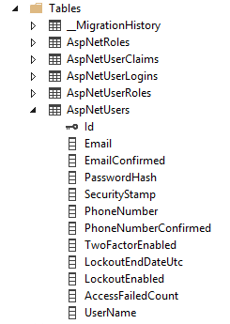
Default Identity 2.0 Schema
Supports user accounts with multiple identity providers per account and roles
Default storage using LocalDB
AspNetUsers
AspNetRoles
AspNetUserRoles
AspNetUserLogins
AspNetUserClaims
Uses Entity Framework and Data Migrations to manage consistency of schema to application

Slide 12
Authentication in the Web
Username & Password
Plain text
Uses HTML forms
Domain user token
Hashed tokens (Kerberos / NTLM)
Can be used with SSO (Single Sign On)
X.509 client certificate
More secured than usernames
Can be used between domains
Federated token
Delegate the authentication to someone else
Authenticate in any way supported
Implemented by various protocols (SAML, OpenID, OAuth)

Slide 13
Enabling 3rd Party Identity
Think Google, Facebook, Twitter, Live ID, LinkedIn…
OAuth and OpenID based
Token servers that provide information about users
Don’t have to manage passwords

Slide 14
Secure by Default
Authentication
Authorization
Manage Secrets
Simple Authorization
Role-based
Claims-based
Policy-based

Slide 15
Secure by Default
Authentication
Authorization
Manage Secrets
DPAPI – Data Protection API
Protect Secrets in development
Azure Key Vault Provider

